Slide 1
Barreleye G2 2.0 OU system Thermal Simulation Report rev. R08

Slide 2
Revision control table
Rev. | Description | Owner | Date
R08 | Change SSD power consumption from 4.1watt to 5.0 watt. | Honda | 2016/12/30

Slide 3
Purpose and Condition
Purpose:
To estimate SSD thermal status with power consumption 5.0 watt
Condition
1. All fan run and N+1 fan redundancy.
2. At ambient 35 ﾟC .
CFD Software:
FLOTHERM v11.1
Notes:
‹#›
‹#›

Slide 4
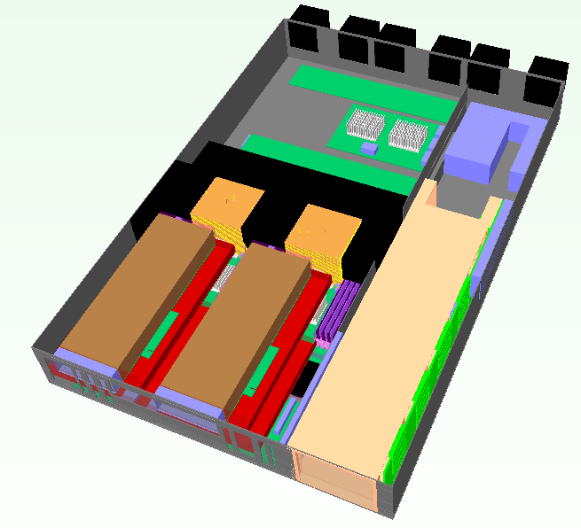
System placement
Fan1
Fan2
Fan3
Fan4
Fan5
Fan6
Expender Board
DIMM x32
VTM
VTM
CPU1
CPU2
2.5” HDD Drawer
Nvidia K80 *2
Power Brick
Air flow direction

Slide 5
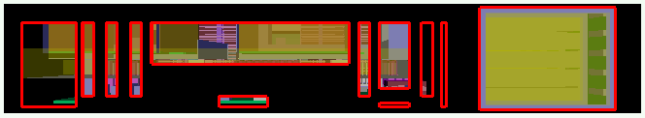

System Inlet / Outlet venting
Venting (open ratio=60%)
Front view
Rear view

Slide 6
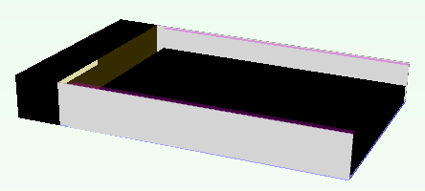
2.5” SSD model
Flotherm model
The height of SSD is 7mm.

Slide 7
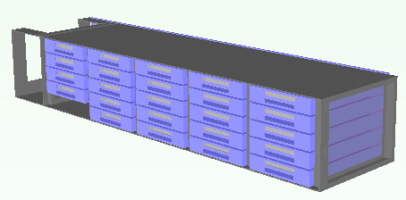
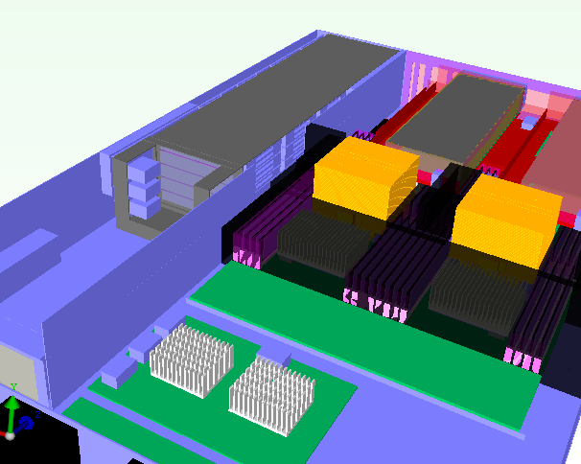
2.5” SSDs Support Location
HDD Q’ty x 24PCS
Sponge to prevent air flow bypass
Venting for HDD

Slide 8
System configuration
Component | TDP (watts) | Q’ty. | Note
Power CPU | 225 | 2 | Spec, Tj, 85C
Memory | 5 | 32 | Spec, Tc, 85C
2.5” SSD | 5.0 | 24 20 | SSD, Tc, 70C *. refer to page.8
K80 | 300 | 2 | Spec, 14.5 CFM
VTM | 66 | 2 | Spec, Tc, 110C
6056 Fan |  | 6
Power Brick | 18.11 | 1 | Flotherm Model provided from vendor

Slide 9
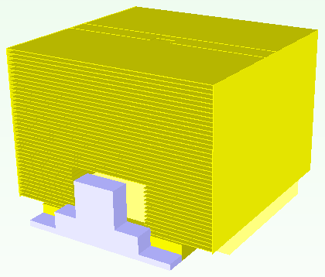
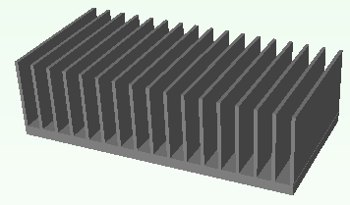
Thermal solution – Heat-sink
85 mm
90 mm
68.2mm
40 mm
CPU HSK
90 x 85x 68.2 mm
Copper base
Cu fin
Heat pipe x4
TIM: Pad K=7.7
VTM HSK
40x80x25 mm
Al extrusion (18 fins)
TIM: Pad K=1.75

Slide 10
Thermal solution – Heat-sink
57.3 mm
VTM HSK-2
57.3x80x32.6 mm
Al extrusion (18 fins)
TIM: Pad K=1.75

Slide 11
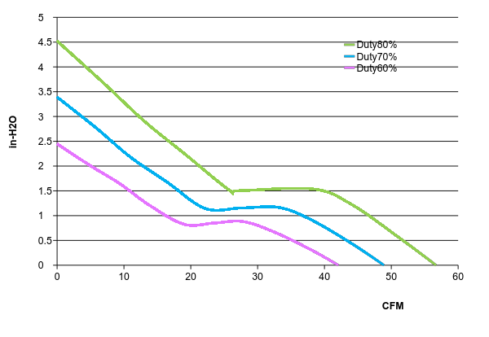
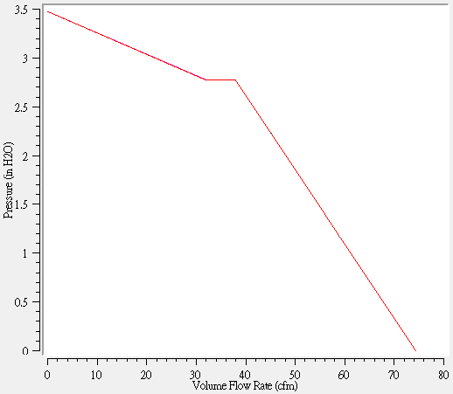
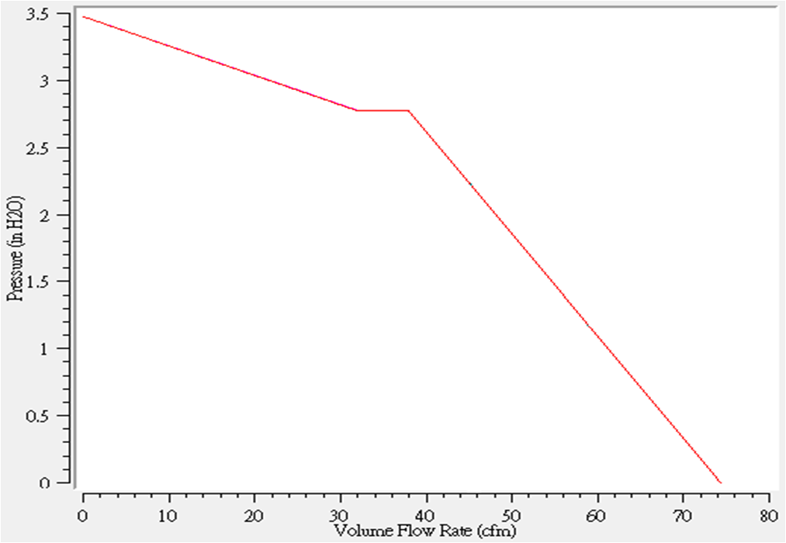
Thermal solution – FAN
PQ curve_PF60561BX-0000-S99_DS 60x60x56mm

Slide 12
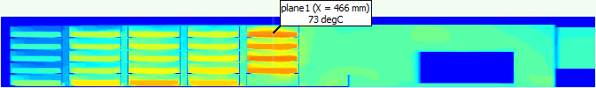
Simulation Result – 2.5” SSD x24
Fan condition |  | Normal
System fan duty |  | 6fans, fan duty@100%
Simulation result | SPEC
Ambient Temp | NA | 35
CPU Power | NA | 225
CPU0 Inlet avg. | NA | 47.2
CPU0 Tj max | 85ﾟC | 80.8
CPU1 Inlet avg. | NA | 46.2
CPU1 Tj max | 85ﾟC | 79.6
DIMM Temp (Max.) | 75ﾟC | 54.1
VTM Temp(Max.) | 100ﾟC | 91.8
2.5" SSD Temp (Max.) | 70ﾟC | 73.0
Power Brick, HSP Temp | 115ﾟC | 57.8
SAS chipset Temp | 105ﾟC | 68.0
K80-1 CFM | 14.5 CFM | 19.9
K80-2 CFM | 14.5 CFM | 23.4

Slide 13
Simulation Result – 2.5” SSD x20
 | SPEC | 6 fans | Fan1 fail | Fan2 fail | Fan3 fail | Fan4 fail | Fan5 fail | Fan6 fail
Ambient Temp | NA | 35 | 35 | 35 | 35 | 35 | 35 | 35
CPU Power | NA | 225 | 225 | 225 | 225 | 225 | 225 | 225
CPU0 Inlet avg. | NA | 46.9 | 48.1 | 49.1 | 48.7 | 47.7 | 47.5 | 47.7
CPU0 Tj max | 85ﾟC | 80.8 | 82.4 | 82.3 | 82.3 | 82.3 | 82.1 | 82.3
CPU1 Inlet avg. | NA | 46.1 | 47.4 | 47.3 | 49.1 | 47.4 | 48.1 | 47.5
CPU1 Tj max | 85ﾟC | 79.5 | 80.9 | 80.8 | 81.0 | 81.0 | 80.8 | 81.1
DIMM Temp (Max.) | 75ﾟC | 54.0 | 57.9 | 58.0 | 58.1 | 57.4 | 57.6 | 57.5
VTM Temp(Max.) | 100ﾟC | 91.6 | 93.2 | 93.3 | 93.3 | 93.2 | 93.1 | 93.3
2.5" SSD Temp (Max.) | 70ﾟC | 67.4 | 70.3 | 70.1 | 70.1 | 70.1 | 69.5 | 70.0
Power Brick, HSP Temp | 115ﾟC | 57.8 | 59.7 | 59.6 | 59.6 | 59.6 | 59.4 | 59.6
SAS chipset Temp | 105ﾟC | 68.1 | 70.1 | 71.8 | 71.7 | 69.8 | 69.6 | 69.8
K80-1 CFM | 14.5 CFM | 20.0 | 17.7 | 17.8 | 17.8 | 17.7 | 18.1 | 17.7
K80-2 CFM | 14.5 CFM | 23.5 | 20.8 | 20.8 | 20.8 | 20.8 | 21.1 | 20.8

Slide 14

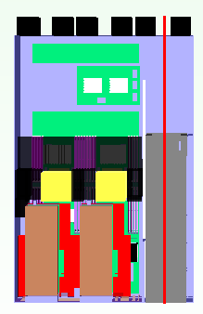
2.5” SSD Temperature Profile _ 6 Fans Run
X=446mm
6 fans
Worst location

Slide 15






2.5” SSD Temperature Profile _ 5 Fans Run
5 fans, Fan1 failed
5 fans, Fan2 failed
5 fans, Fan3 failed
5 fans, Fan4 failed
5 fans, Fan5 failed
5 fans, Fan6 failed

Slide 16
Simulation Result –Temperature
Conclusion :
CPUs temperature can meet IBM CPU spec at normal fan condition and one fan failed condition.
SSD with power consumption 5.0 watt can’t support to 24 PCS. If reduce Q’ty to 20 PCS, SSDs temperature are critical pass.
Nvidia K80 can meet vendor spec.
Other components can meet thermal spec.

